Slide 1
Autonomous Vocal and Backing Track Mixing
Master Project Proposal
Kelian (Mike) Li
Music Informatics Group

Slide 2
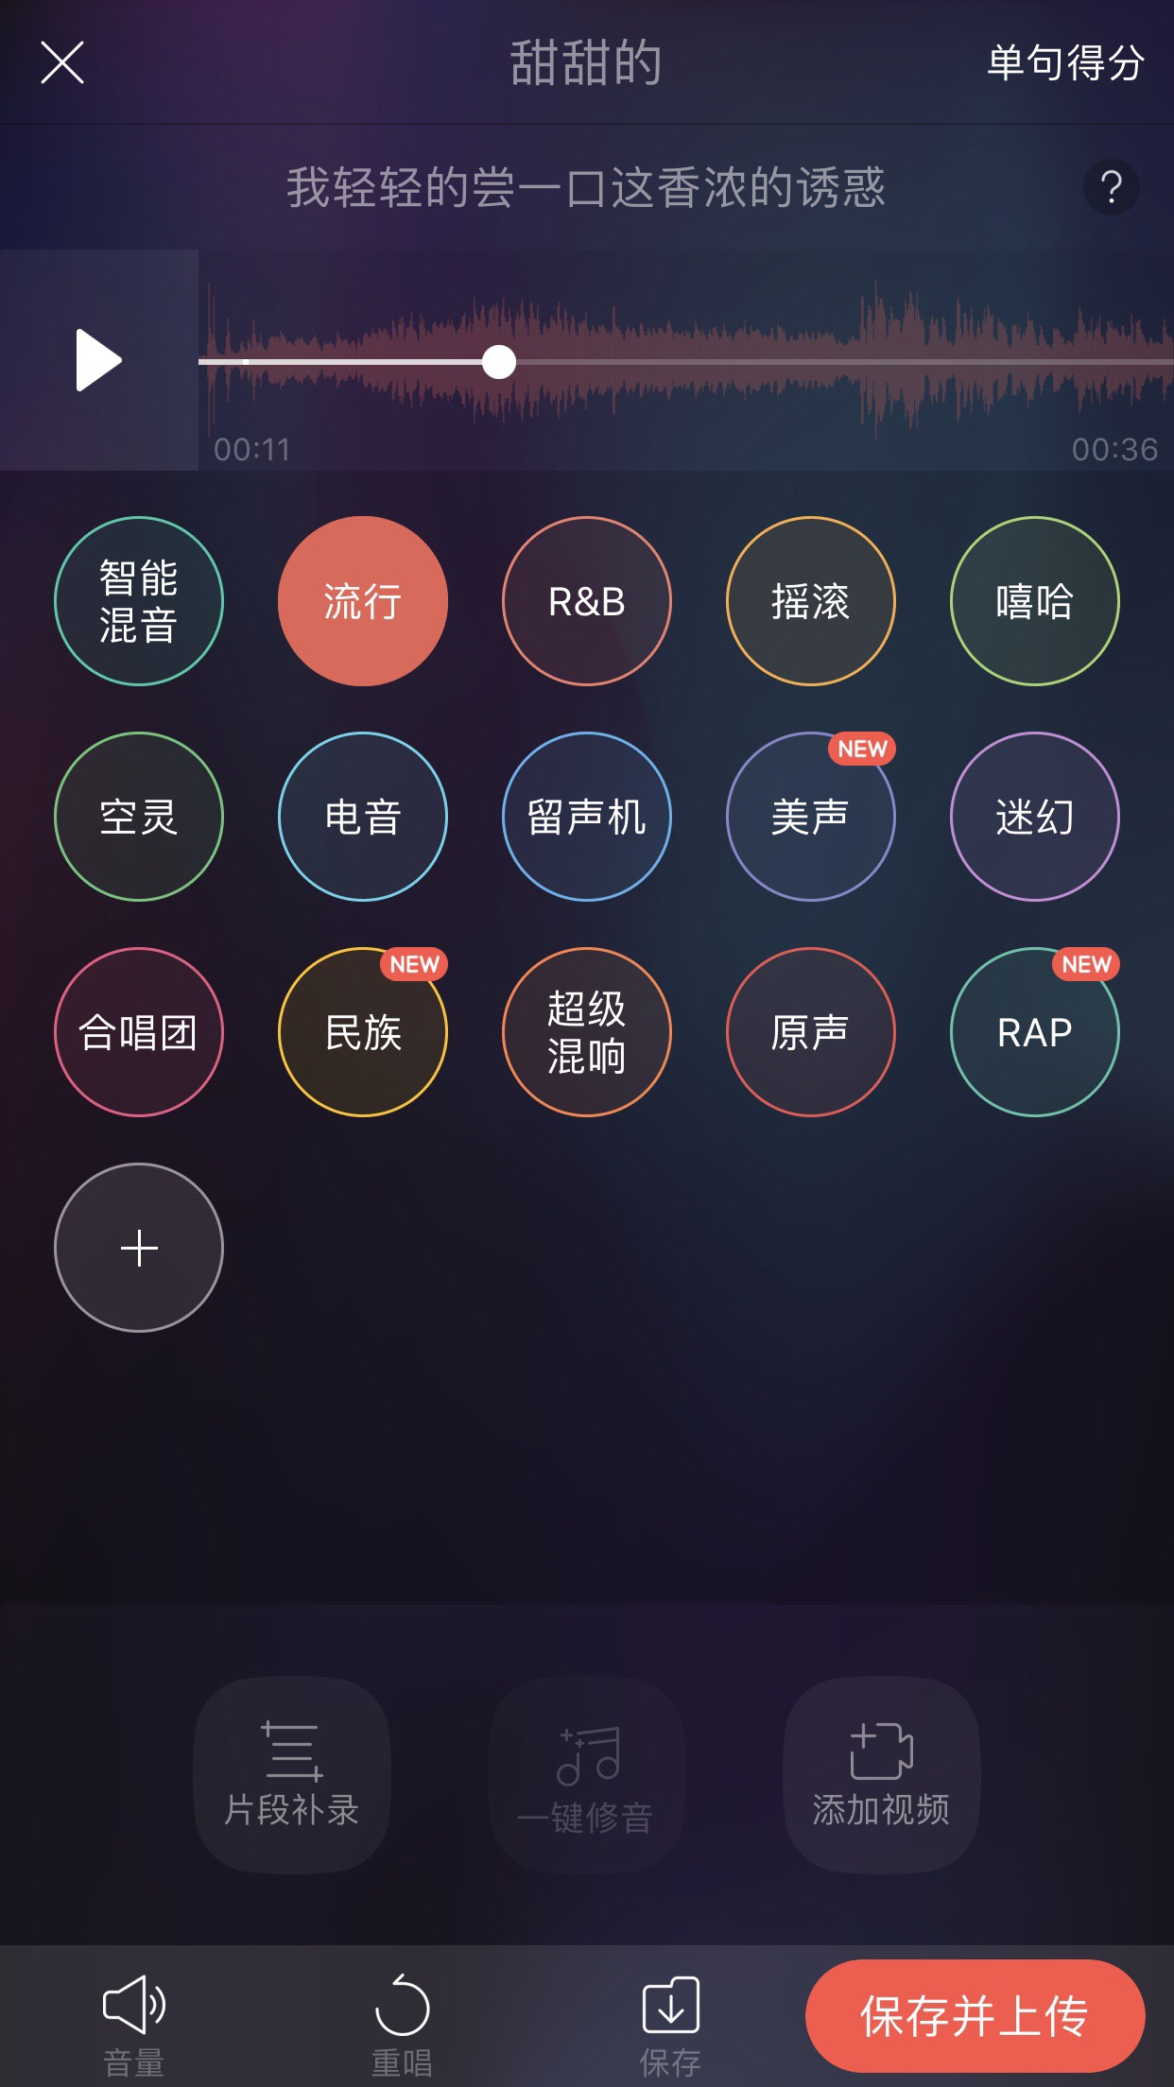
Motivation
Karaoke apps

Slide 3
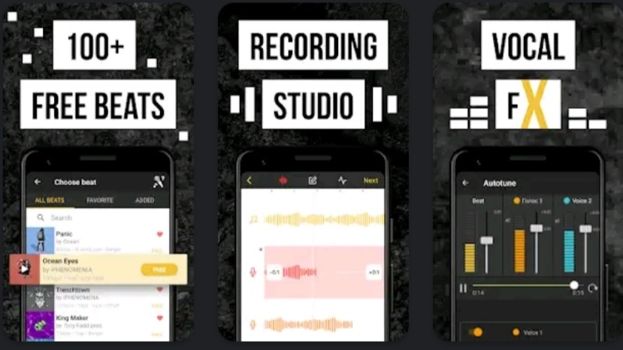
Motivation
Karaoke apps
Amateur music makers

Slide 4

Related Works
Over 10 years of study on automatic mixing
Mixing rules and mix analysis

Slide 5
Baseline system
Level balance
−3 dB vocal-to-mix ratio
Compression
14 dB loudness range
EQ
Frequency masking
Reverb
?

Slide 6
Related Works
Recent deep learning methods
End-to-end audio transformation
Differentiable digital signal processing
Black-box audio effects control with gradient approximation
Lack of paired raw tracks and mixed tracks for training

Slide 7
Proposed Method
Maps the input audio to mixing parameters
Outputs mixing parameters which allows human adjustment
The challenge is the mixing parameter gathering
Requires only mixed vocal and backing tracks for training
Raw vocal tracks are not needed

Slide 8
Proposed Method -Level Balance and Compression
The model outputs intermediate audio features (relative loudness and loudness range)
Post-processing converts the intermediate features into mixing parameters

Slide 9
Proposed Method -Level Balance

Slide 10
Proposed Method -Compression

Slide 11
Proposed Method -Equalization
The “raw” tracks for training are self-generated by applying EQ to the mixed vocal tracks. The corrected parameters are known.

Slide 12
Proposed Method -Equalization

Slide 13
Proposed Method -Reverberation
Extracts the reverb impulse responses by a commercial plugin
Uses genetic optimization to approximate the reverb parameters for the impulse responses

Slide 14
Proposed Method -Reverberation

Slide 15
Timeline
March
Baseline system implementation
November
Subjective listening test
December
Paper writing
April
Summer
September
October
Reverb parameter extraction
Data collection
Level balance
Reverb parameter extraction
Compression
Equalization
Reverberation
Experiment preparation

Slide 16
Thank you!

